Slide 1
Auto Evaluation of NDT Data
BINDT Aerospace Event
April 2018
GKN Aerospace - Global Technology
This document contains no technical data

Slide 2
Auto Evaluation of NDT Data
Contents
What is Industry 4.0?
Design principles of Industry 4.0
How can NDT benefit from Industry 4.0?
NDT as a solution, rather than a burden
Machine Learning: Use for Automated Defect Recognition (ADR)
ADR Process challenges: Case study Ultrasonic Techniques
Next Steps: Leveraging the NDT Industry
This document contains no technical data

Slide 3
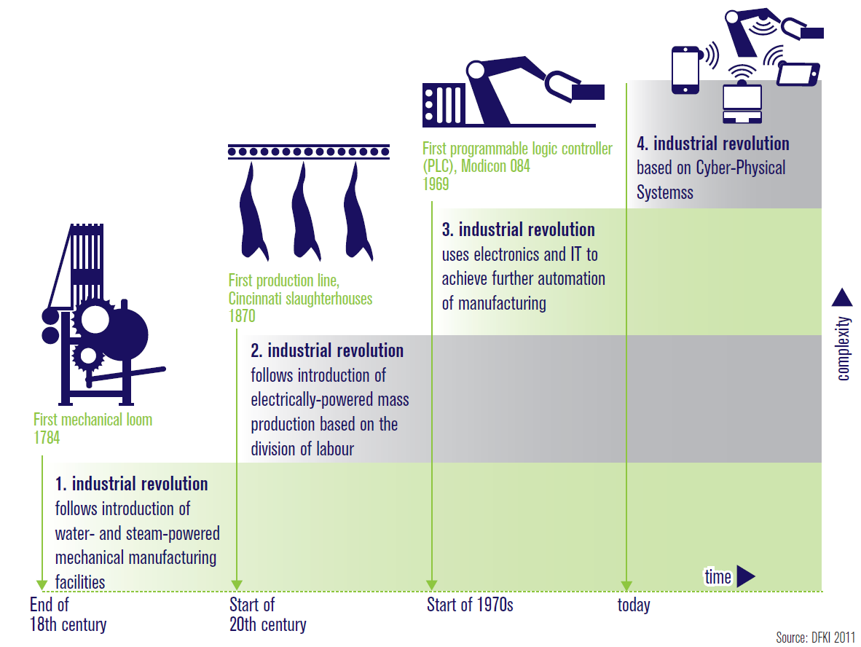
What is Industry 4.0?
Industry 4.0
This is referred to the 4th Industrial revolution, as defined below:
Industry 4.0 covers two aspects:
These are systems/sensors with embedded microprocessors, which enable the convergence of physical and virtual world in the form of “Cyber-physical Systems”
the possibility to network resources, information, objects and people to create the Internet of Things (IoT)
This document contains no technical data

Slide 4
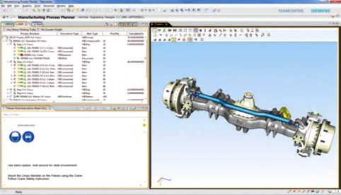
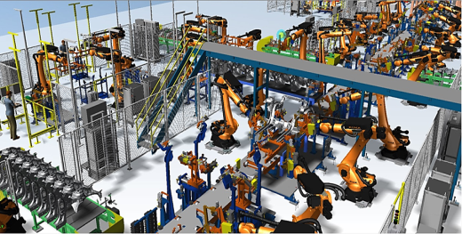
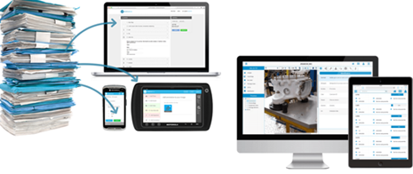
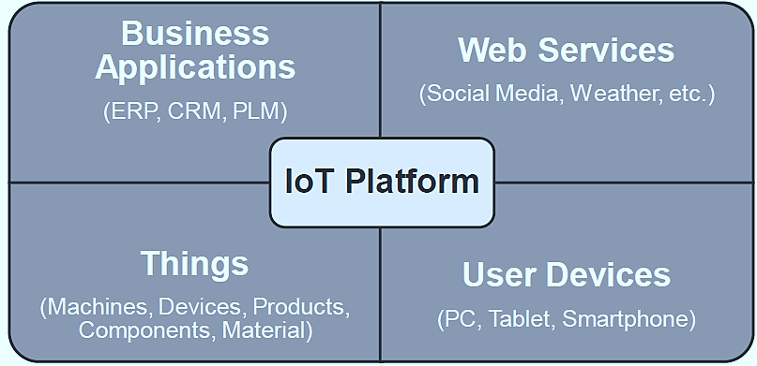
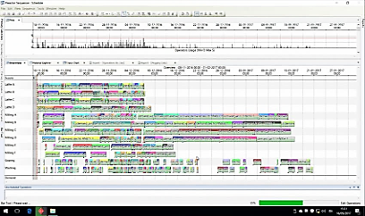
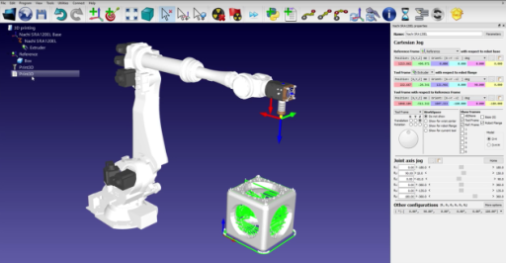
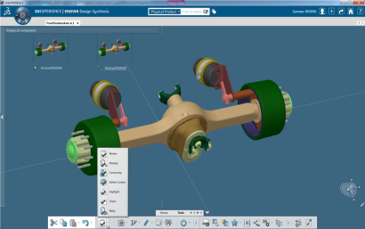
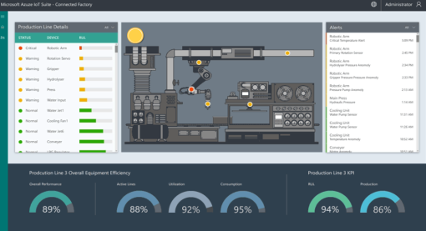
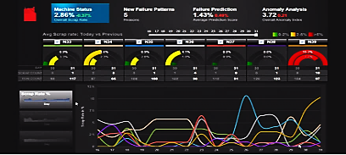
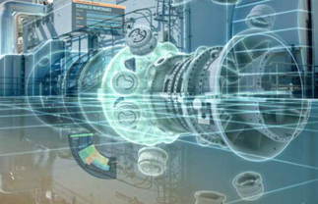
What is Industry 4.0?
Electronic work instructions
Augmented reality
Plant Simulation software
Manufacturing Operation Management (MOM)
Planning & Scheduling
Robot Simulation
Robot Simulation
Predictive maintenance
PLM Solutions
Remote expert assistance
Design/stress Simulation
This document contains no technical data

Slide 5
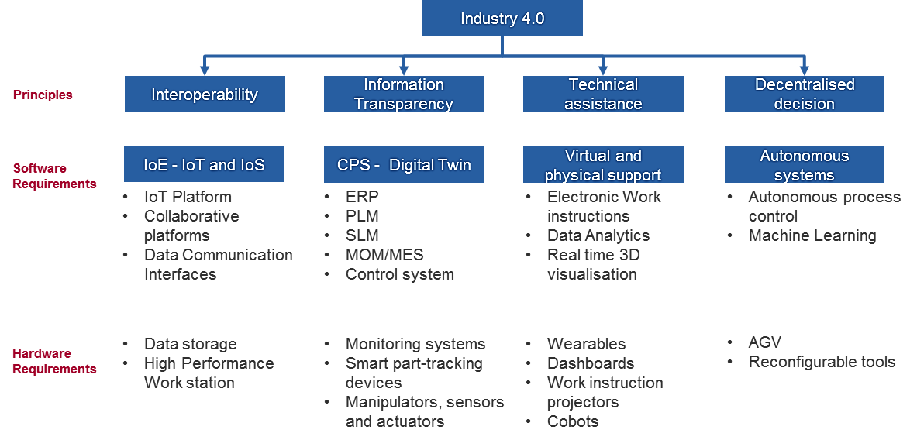
Industry 4.0 Design Principals
Interoperability: The ability of systems to communicate via the Internet of Things (IoT)
Information transparency: The ability of information systems to create a virtual copy of the physical world by enriching digital plant models with sensor data
Technical assistance: the ability of assistance systems to support humans by aggregating and visualizing information comprehensibly for making informed decisions and solving urgent problems on short notice.
Decentralized decisions: The ability of cyber physical systems to make decisions on their own and to perform their tasks as autonomously as possible
This document contains no technical data

Slide 6
How can NDT benefit from Industry 4.0?
One of the BINDT Aerospace community objectives is “to change the perception of NDT into being a solution rather than a burden, by promoting the benefits of NDT methods within the design, production and maintenance communities.”
The other benefit is through machine learning, which can assist with Automated Defect Recognition (ADR).
This document contains no technical data

Slide 7
Auto Evaluation of NDT Data – NDT as a solution…
Monitoring systems:
This relies on NDT data produced from automated equipment
feedback of NDT data to make faster output diagnosis
Possible additional steps
Data Acquisition
Data Processing
Manual interpretation
Manual Reporting
Concession logging
Concession processing
Product Rework
Data Acquisition
Data Processing, Automated Defect recognition, Automated Reporting, linked directly into concession system
Product Rework
Rapid feedback to aid process development
Digital Twin:
A digital twin which can simulate NDT defects through validated models, can make predictions on effects of defects.
Requires validation of models at the part qualification stage
Benefits include:
Improving design allowables
Quicker judgement of effects of defects - concessions can be processed quicker - potentially preventing scrap
This document contains no technical data

Slide 8
Auto Evaluation of NDT Data – through Machine Learning
ARTIFICAL INTELLIGENCE
Design an intelligent agent that perceives its environment and makes decision to maximize chances of achieving its goal.
Sub Fields: vision, robotics, machine learning, natural language processing, planning….
MACHINE LEARNING
Gives “computers the ability to learn without being explicitly programmed” (Arthur Samuel, 1959)
SUPERVISED LEARNING
Classification, regression
UNSUPERVISED LEARNING
Clustering, dimensionality reduction, recommendation
REINFORCEMENT LEARNING
Reward maximization
This document contains no technical data

Slide 9
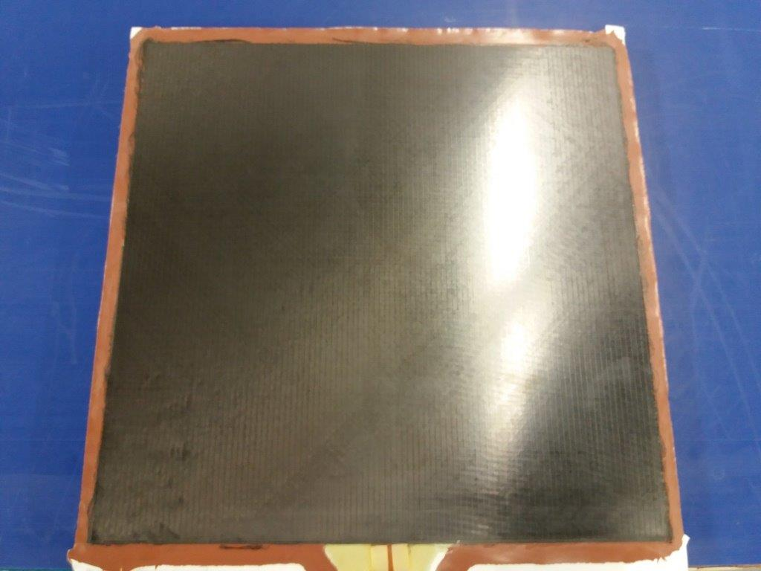
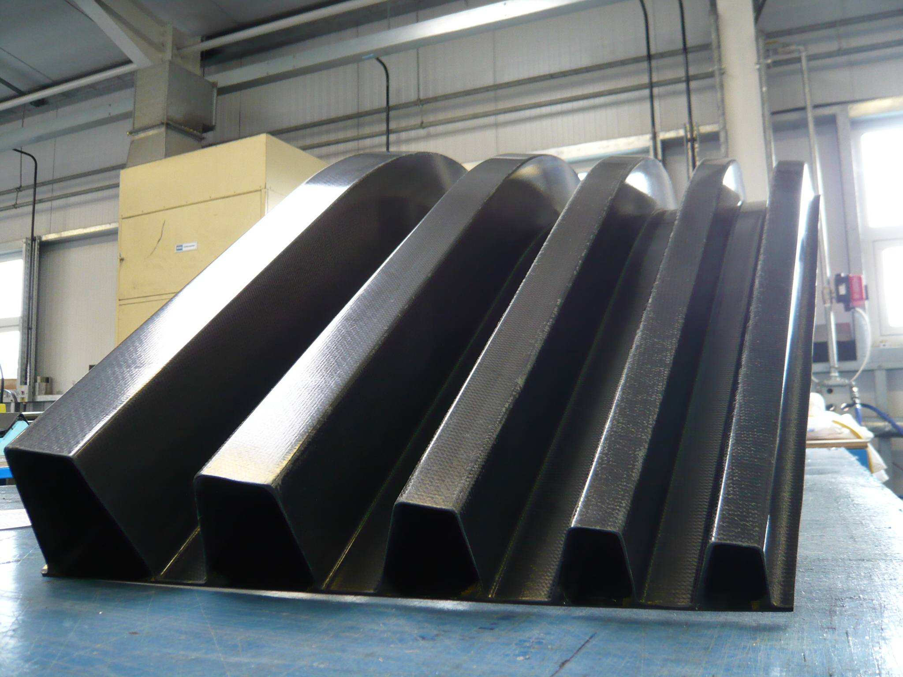
Auto Evaluation of NDT Data – Case study: Ultrasonic Techniques
Increasing challenge to make ADR a success
Components suited to ADR
Test coupons and simple flat / ”slightly curved” parts
Net moulded surfaces or consistently moulded surfaces
Parts with well defined datum features and edges
Features not conducive to ADR:
machined sacrificial areas
integrated stiffeners and/or sub spar sections
Small radii, particularly thick small radii
Ramps, especially inconsistent ramp rates
Multi material layup (i.e. mixture of glass and carbon)
This document contains no technical data

Slide 10
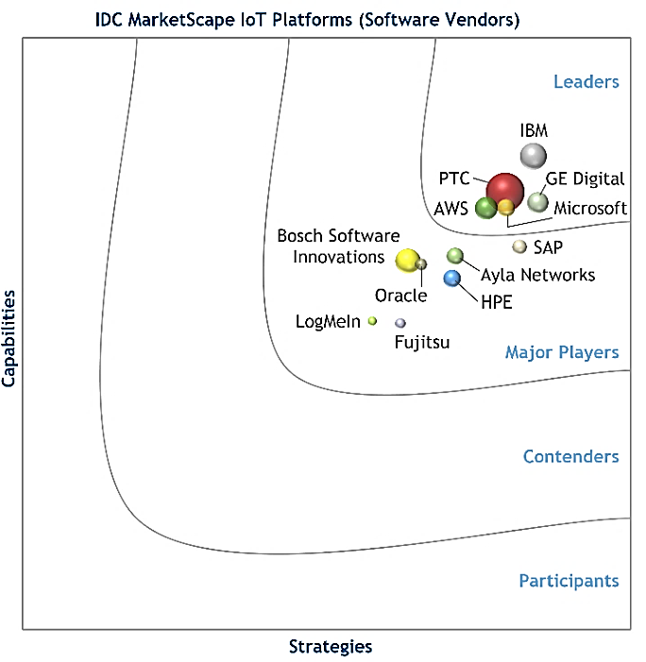
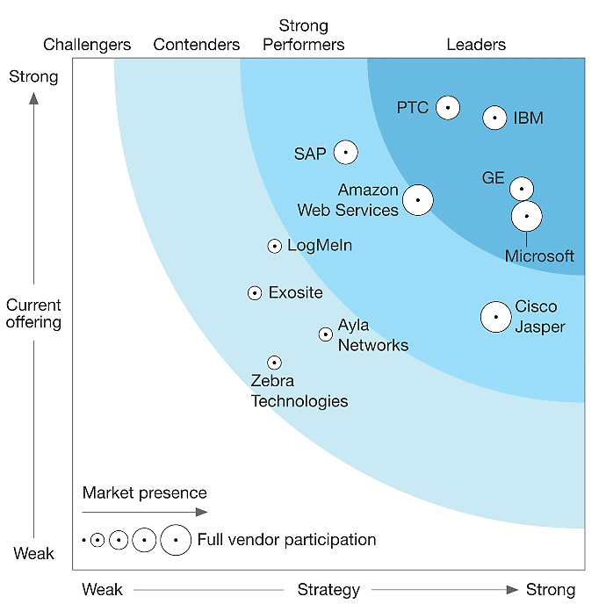
Next steps?
To integrate with Industry 4.0 systems
There are key software suppliers that have integrated factory solutions. GKN has done a down selection
There already have been market studies on these suppliers
NDT systems will need to be compatible with these key suppliers
IDC MarketScape (2017)
Forrestor Wave Research Q4 2016
Key steps for the NDT Industry?
Continue to improve data acquisition thereby improving NDT data quality
Automation of NDT processes is essential (this is Industry 3.0!) – cannot progress to Industry 4.0 without this
Continue work on defect simulation technologies for digital twin
Important to work on standardization of data formats - particularly for new technologies
This document contains no technical data

Slide 11
Auto Evaluation of NDT Data
End Presentation
This document contains no technical data

Slide 12
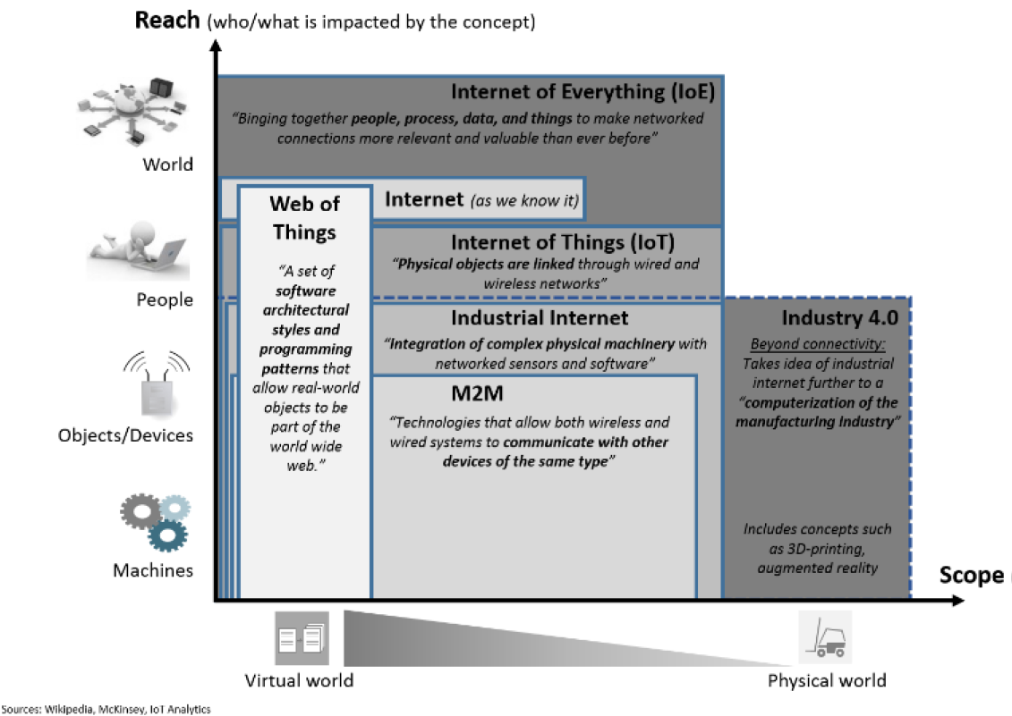
What is Industry 4.0? Extra slide/info…..
IEEE P2413 is an active project that is currently involved in defining an architecture framework, addressing descriptions of various IoT domains, definitions of IoT domain abstractions, and identification of commonalities between different IoT domains.
There is no definitive international standard to describe the definition and architecture for IoT.
There are several other concepts such as Internet of Everything (IoE), Industrial Internet and Machine-to-machine (M2M) which has an overlapping or similar functionality of IoT. A concept disambiguation graph [shown right] explains the distinction in scope of each concept
This document contains no technical data

